Slide 1
Logo animation (intro)

Slide 2


Title slide
Oracle
DATABASE
In A
Container
Martijn Pronk, AMIS | Conclusion

Slide 3
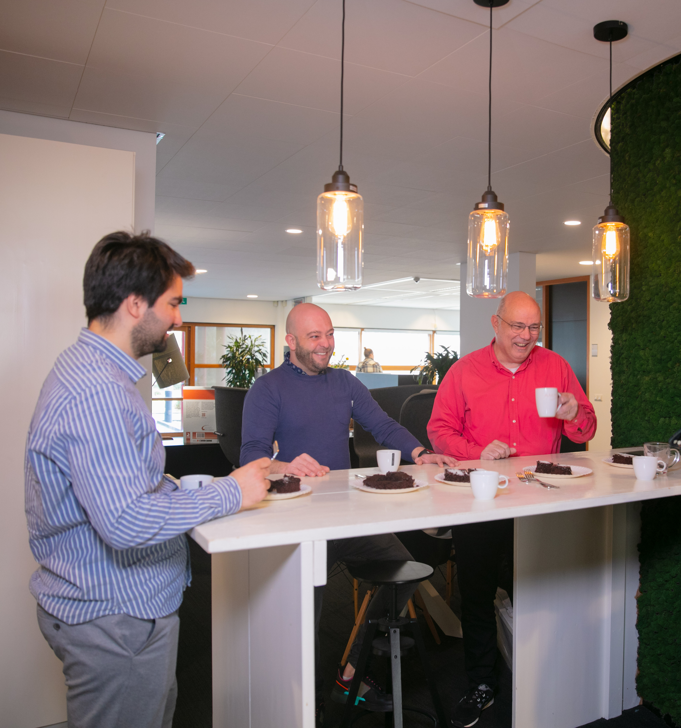
Agenda (8x)
agenda
1
Intro
2
Containers: podman / docker
3
Oracle database containers
4
        Getting started (locally)
5
GitPod (online)
6
Questions

Slide 4

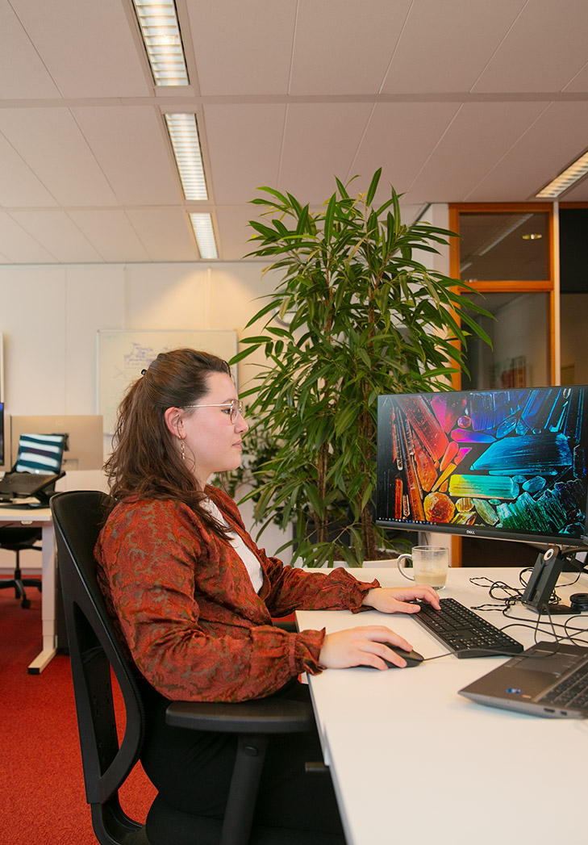
Intro
    Martijn Pronk
    7 years at AMIS
    (technical) principal consultant
Mostly working on infrastructure side, automation and cloud stuff
Doing that for different customers over the years
Find my blog articles at https://technology.amis.nl/author/martijn_p/
Notes:
AMIS Conclusion is een pionier op het gebied van moderne technologie, die intelligent operations mogelijk maakt door het activeren van real-time data. We zijn trots op de tastbare impact die we creëren; AMIS Conclusion doet waar anderen over praten.
Bij AMIS Conclusion geloven we sterk in de kracht van samenwerking. Voor onze klanten én voor onszelf streven we naar vooruitgang, hebben we plezier, dromen we over de toekomst, maken we plannen, gaan we uitdagingen aan, bereiken we resultaten en vieren we successen. Onze bedrijfscultuur kenmerkt zich door passie. We houden van het doorgronden van technologie, we zijn trots op de impact van ons werk en we zijn gefocust op het begrijpelijk maken van complexiteit en het realiseren van werkende toepassingen.

Slide 5
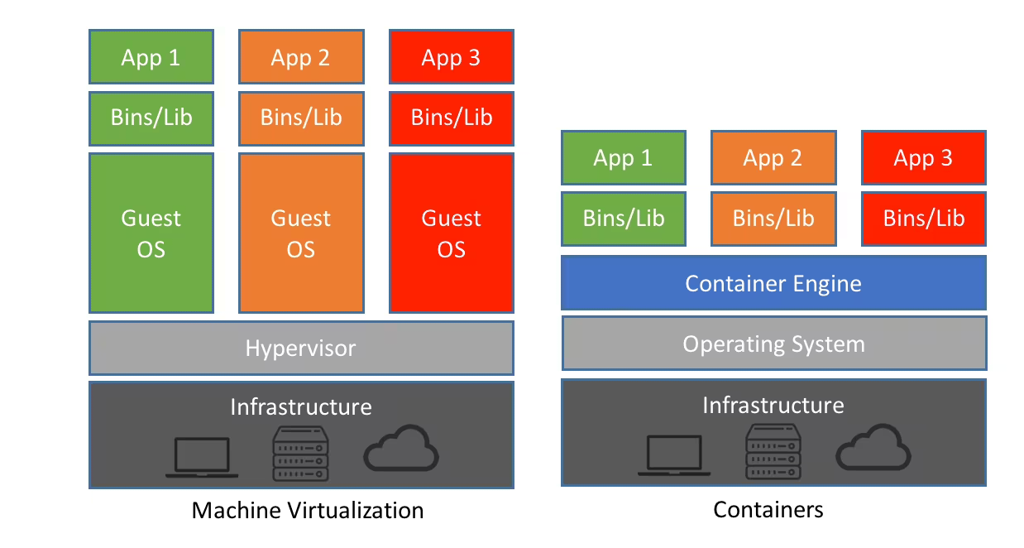

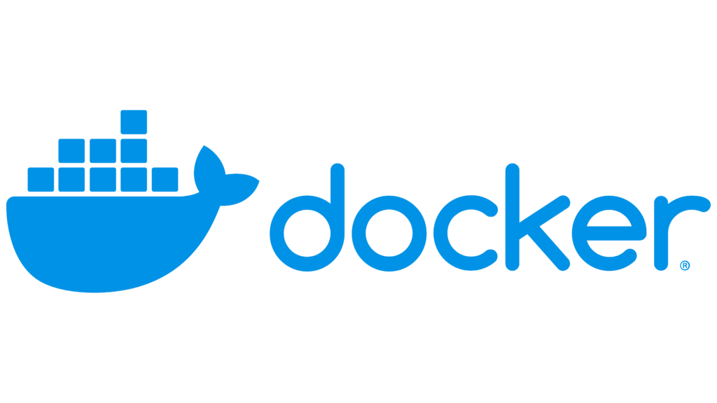
Containers: Podman and Docker
A container is a light-weight partition within the (Linux) OS to separate running processes from others
Provide a “OS” like isolated environment
Docker is most well known, however, it has it’s licensing limitations
Podman is a drop in replacement for docker.
Both docker and podman provide an easy to use commandline/gui environment to manage containers
Containers can be downloaded from a container registry or you can build them yourself.
Note: both on MacOS and Windows a separate Linux based VM is started to provide the Linux kernel required to run Linux binaries.
Additionally, since Apple switched to Apple Silicon (ARM) based cpu’s, tools to run x86-64 containers are made available.

Slide 6
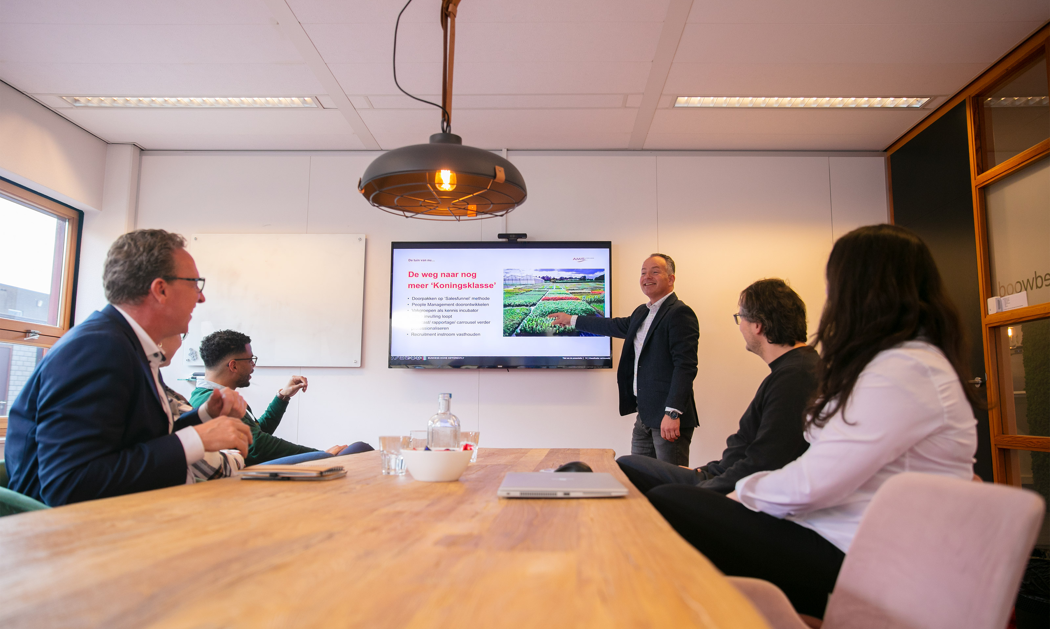
Chapter Introduction
        ORACLE DATABASE
        containers

Slide 7
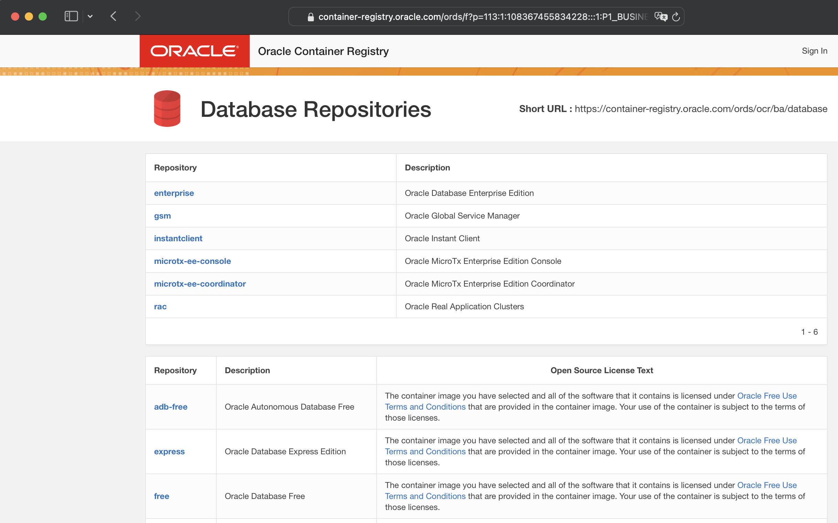
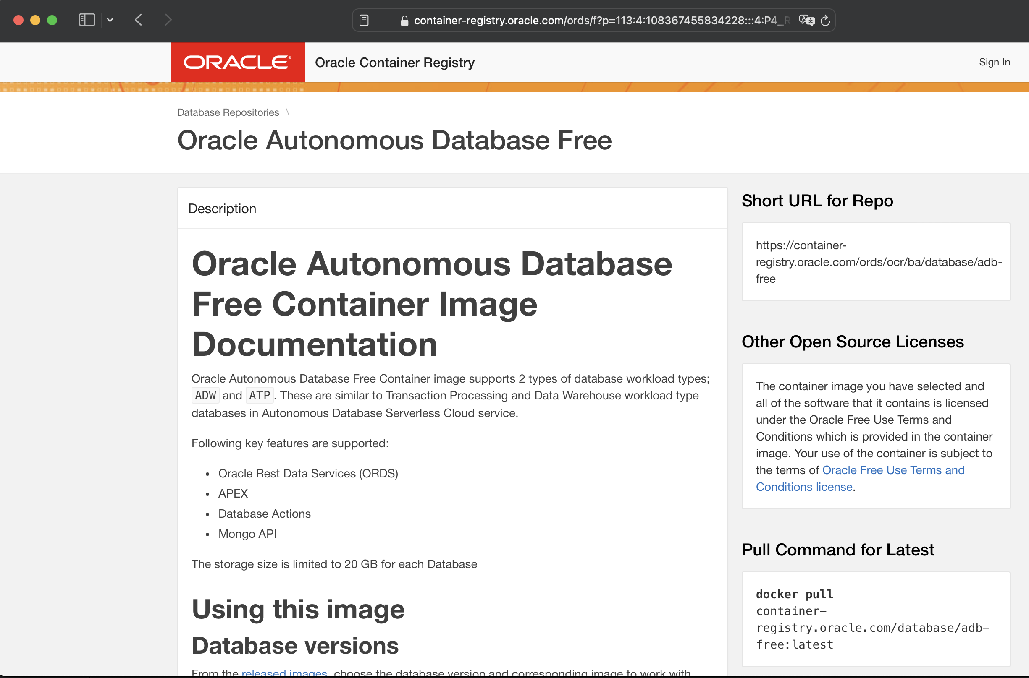
ORACLE provided containers
Oracle provides pre-built, free to use container images
Instructions can be found at https://container-registry.oracle.com/ords/ocr/ba/database
Autonomous database can be downloaded in both 19c and 23ai editions
Oracle database Free can also be downloaded in 19c and 23ai editions
Biggest difference: Autonomous database will come with preconfigured ORDS and APEX

Slide 8
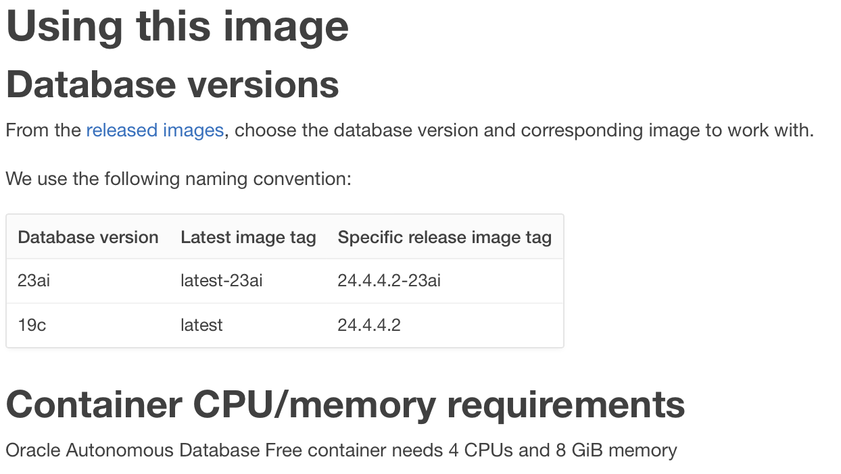
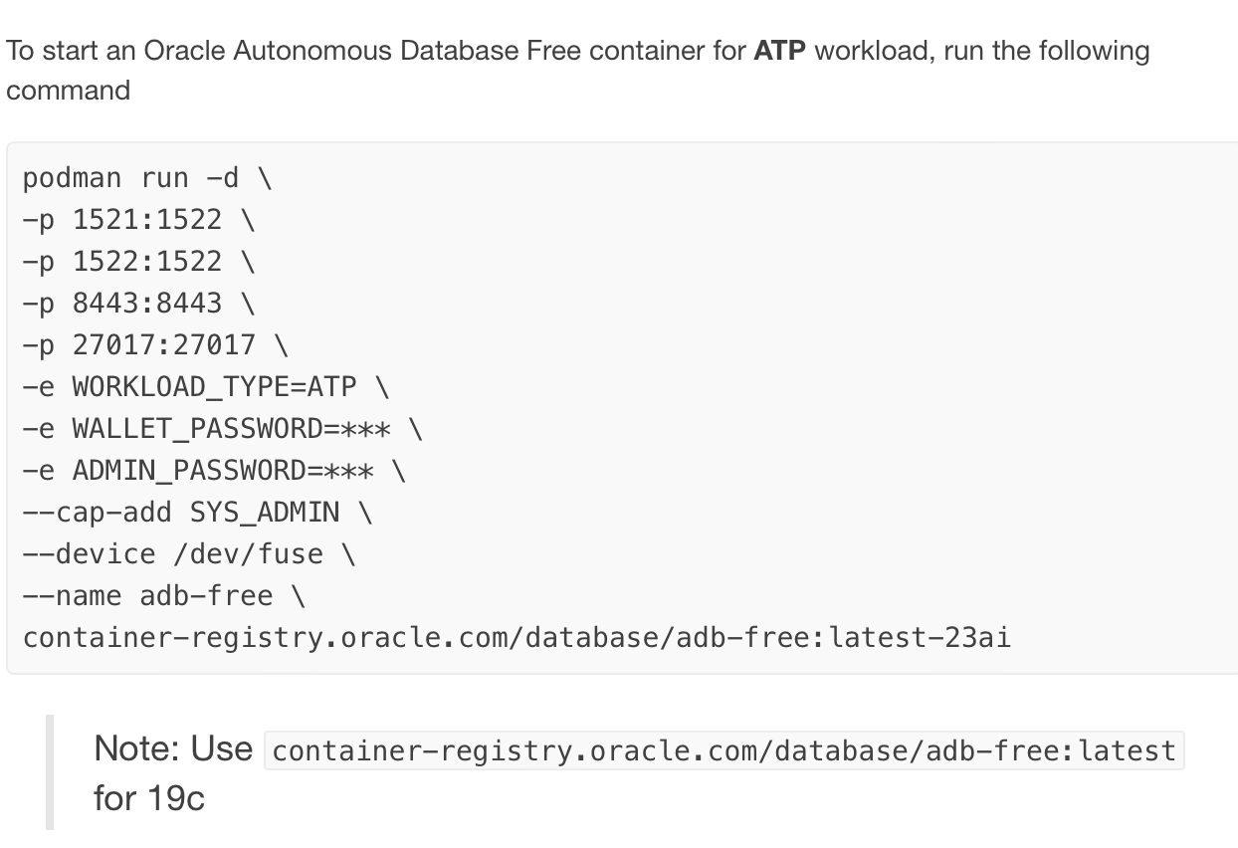
Oracle provided containers
Instructions are available on the container registry pages
Which version to pull (download), what arguments are required/useful
Additional instructions

Slide 9
Chapter Introduction
        GETTING started

Slide 10
Getting started ADB-FREE (23)
For all commands podman usage is assumed, for docker the commands are similar
First pull the container image:
  podman pull container-registry.oracle.com/database/adb-free:latest-23ai
Run the container:
  podman run -d \
  -p 1521:1522 \
  -p 1522:1522 \
  -p 8443:8443 \
  -p 27017:27017 \
  -e WORKLOAD_TYPE=ATP \
  -e WALLET_PASSWORD=MyFavouritePassword#for23ai \
  -e ADMIN_PASSWORD=MyFavouritePassword#for23ai \
  --cap-add SYS_ADMIN \
  --device /dev/fuse \
  --name adb-free \
  -v $PWD/scripts:/opt/oracle/scripts/setup \
  container-registry.oracle.com/database/adb-free:latest-23ai
Done, a running container is created ☺

Slide 11
Getting started ADB-FREE
Viewing logs:
  podman logs -f adb-free
You’ll see:
  the container database being extracted
  a PDB is downloaded from an OCI Bucket and plugged in
  Certificates are created for both ORDS and Listener
  ORDS is configured for SQL Developer Web, Mongo DB, APEX and plain ORDS
  A (cloud) wallet directory is created and filled with correct content
  The database’s alert log and ORDS’s stdout logging

Slide 12
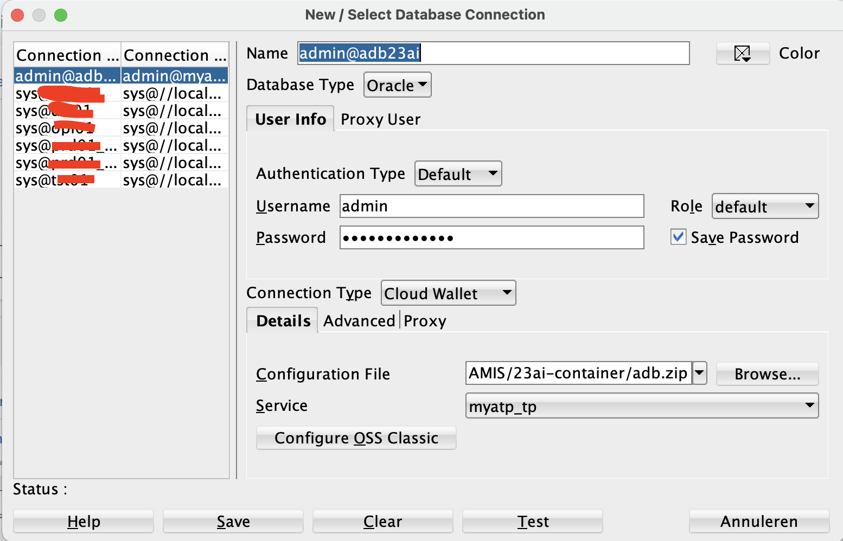
Getting started ADB-FREE
Access your local autonomous DB:
  SQLcl and SQLDeveloper on your system can be used.
  As mentioned in the previous slide: an Autonomous database cloud wallet is available
  Copy the wallet from the container to your own system, zip its contents and you have a cloud wallet ☺
    podman cp adb-23ai-free:/u01/app/oracle/wallets/tls_wallet adbwallet
    cd adbwallet
    zip ../adb.zip *
  SQLcl:
sql -cloudconfig adb.zip admin/password@myatp_tp
  SQL Developer:

Slide 13
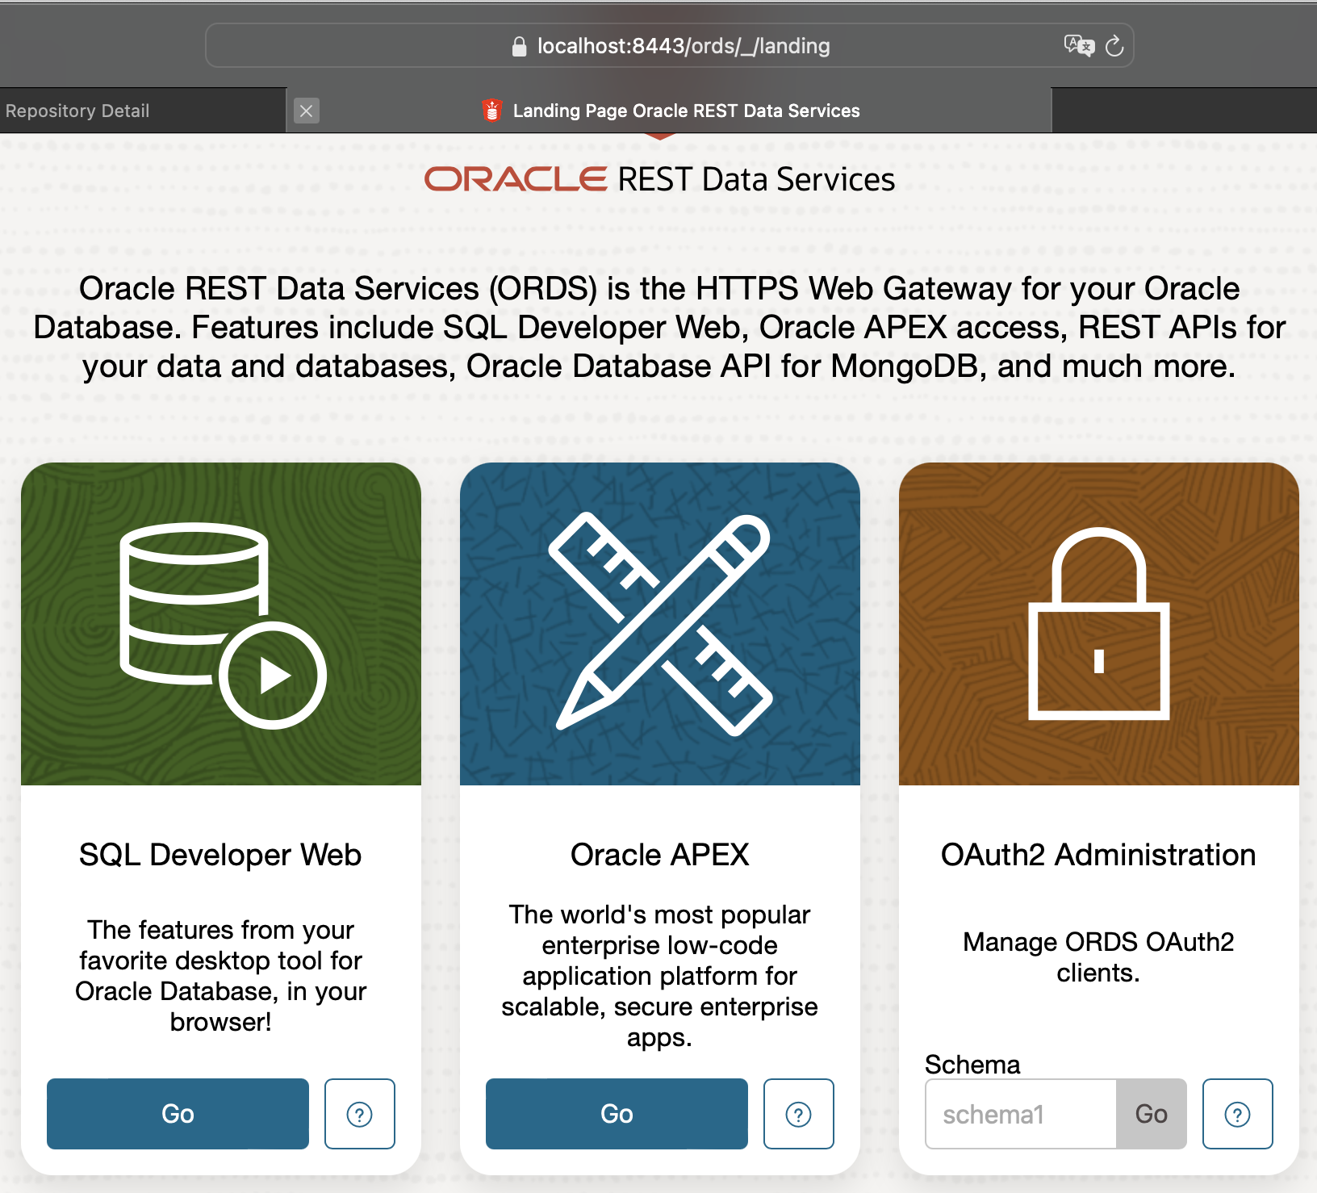
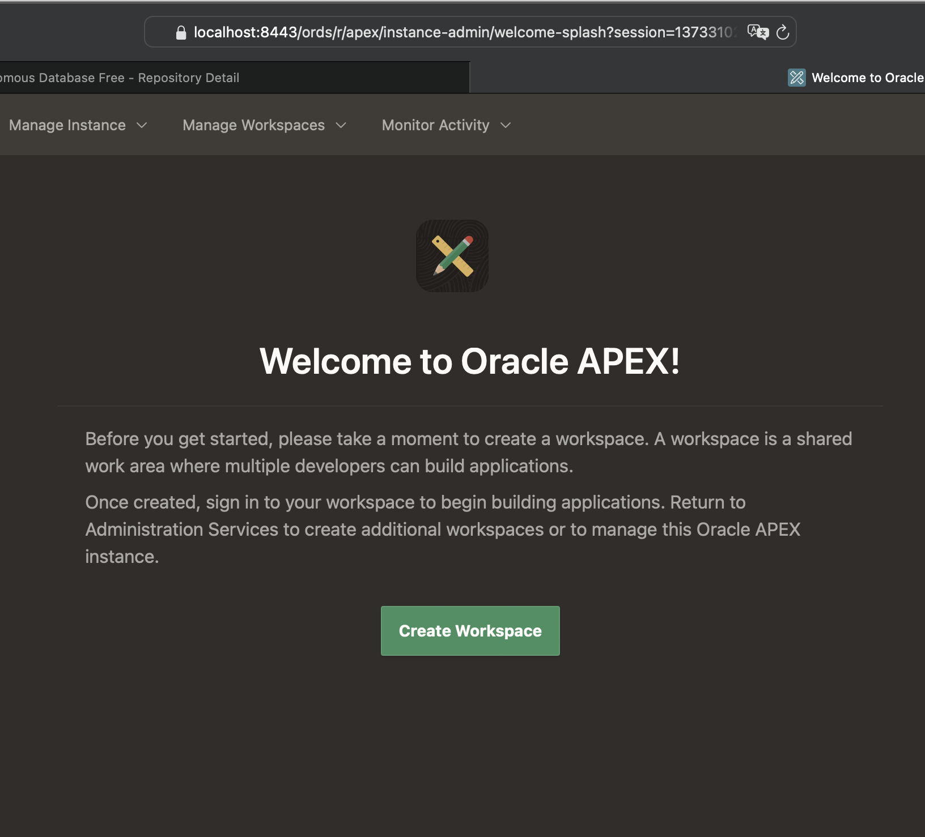
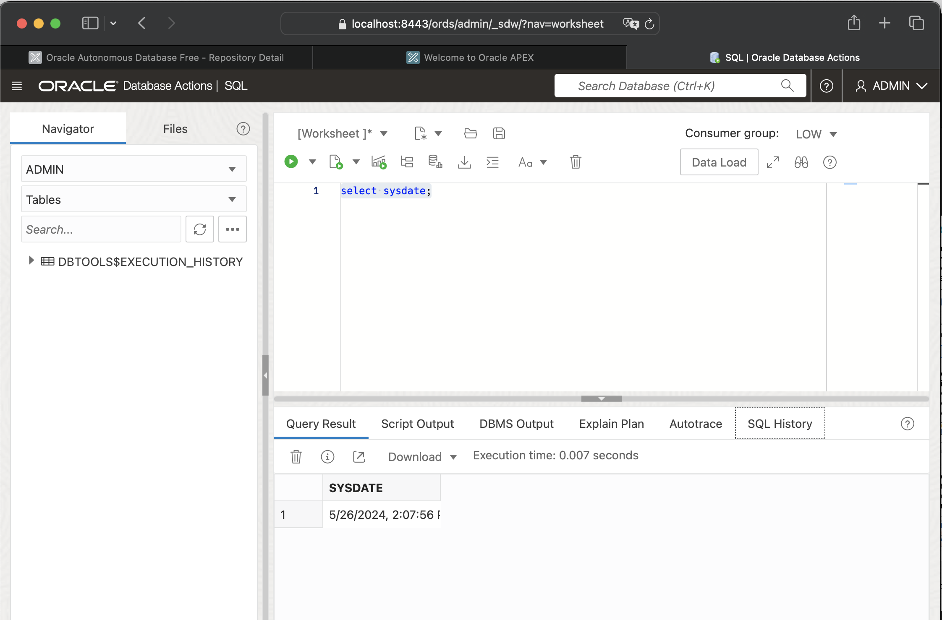
Getting started ADB-FREE
  ORDS/APEX/SQL Developer Web via https://localhost:8443/ords/
  As mentioned, APEX is ready to use, login with the admin user and start creating a workspace
  The ORDS mongodb compatible service is at port 27017: during startup ORDS tells you exactly how to connect:
2024-05-17T12:21:26.269Z INFO The Oracle API for MongoDB connection string is:
mongodb://[{user}:{password}@]localhost:27017/{user}?authMechanism=PLAIN&authSource=$external&ssl=true&retryWrites=false&loadBalanced=true

Slide 14
DEMO time
  #include “internetaccess.h”
  from luck import “a bit of”
  # at least we have the Powerpoint slides and the container I created earlier ;)

Slide 15
Chapter Introduction
        GITPOD

Slide 16
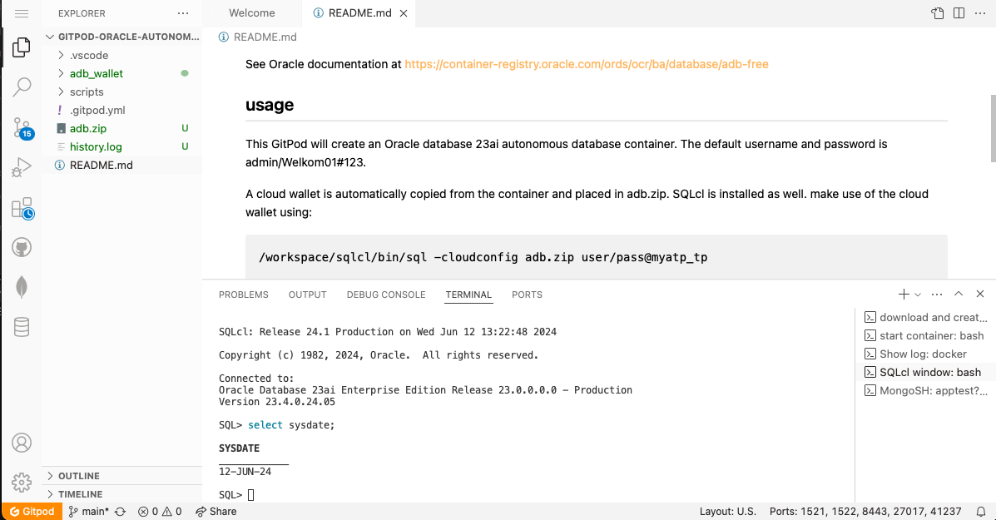
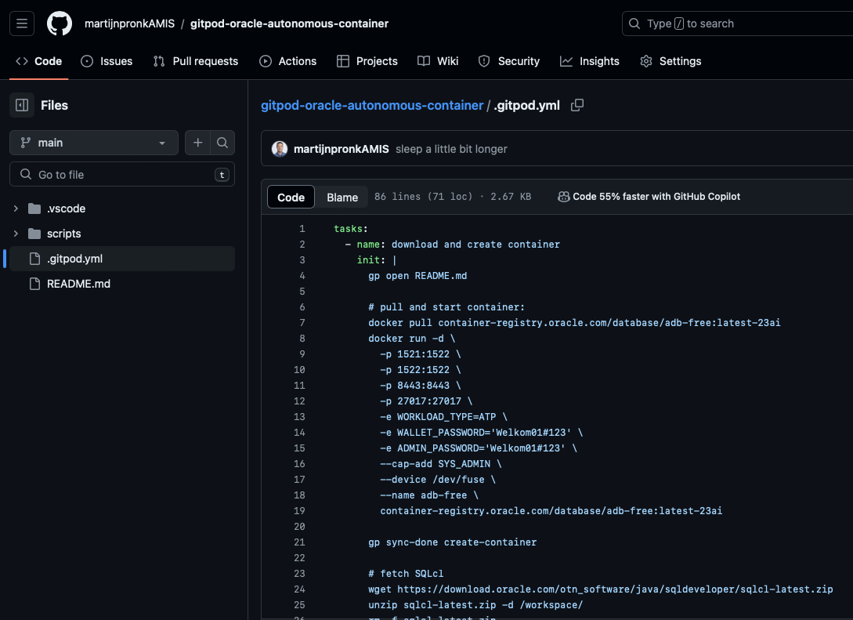
GITPOD
GitPod is a service connected to GitHub.
  Allows you to create a quick container based environment online, without the need to install Docker or Podman locally
  Easy method of providing demo environments, only a github account is required
  Deployed using a yaml file in a github repository, can contain multiple steps to deploy your environment and do some post processing if required
  Built in VS Code online, including ability to install plugins. (or connect to your local VS Code)
  50hrs of free CPU time per month
  Question is… can you run the ADB free container on GitPod
  The answer: YES :)

Slide 17
DEMO TIME Again ☺
  #include “internetaccess.h”
  from luck import “a bit of”
  # at least we have the Powerpoint slides and the container I created earlier ;)
  See URL https://github.com/martijnpronkAMIS/gitpod-oracle-autonomous-container
  Make sure you have a GitHub account to be able to access GitPod

Slide 18
Chapter Introduction
        Questions?

Slide 19

Notes:
Concieve : Conceive Capture Challenge Composition Course Setting Commitment
Construct: Configure, Connect, Combine, Confirm, Continuous Improvement,
Continuity: Comfort,Checks,Conformity,Cost Management,LifeCycle/DisContinuation
Hoe doet AMIS Conclusion dat?
Bij AMIS Conclusion ligt de focus op het doel, het gebruik en het rendement van onze oplossingen. Dat bereiken we in drie essentiële stappen:
Conceive: We begrijpen wat onze opdrachtgever wil bereiken, waar hij momenteel staat en wat haalbaar is.
Construct: We bouwen wat nodig is met behulp van gedegen en toekomstbestendige oplossingen, gebaseerd op onze bewezen best practices.
Consume: We beheersen het rendement en de continuïteit door voortdurende focus op de levenscyclus en actueel gebruik.
AMIS Conclusion streeft naar duurzame relaties door continu waarde te leveren. Onze focus ligt op kwaliteit en het behalen van succes. Onze resultaten worden verwezenlijkt door middel van expertise, ervaring en lef. We zijn voortdurend op zoek naar vernieuwing door nieuwsgierigheid en de ambitie om positieve en toekomstbestendige veranderingen te realiseren.
In onze aanpak werken we pragmatisch, vanuit het hier en nu, aan concrete doelen met het beoogde resultaat voor ogen. We doen geen concessies aan kwaliteit, alleen succes telt.
Bij AMIS Conclusion staat stuwkracht centraal. We leveren de executiekracht om uitdagende situaties aan te pakken, crises te overwinnen en projecten succesvol af te ronden. We maken waar wat we zeggen en gaan verder dan alleen praten over oplossingen.

