Slide 1
Securing ORDS REST services with JSON Web Tokens (JWT)
André van der Put
20-3-2025

Slide 2



About me
Software developer at Open-Fine
Oracle developer since 1997
APEX developer since 2009
a.v.d.put@open-fine.nl
linkedin.com/in/andrevanderput/

Slide 3
Overview
Use case
JSON Web Tokens
Integration with ORDS

Slide 4
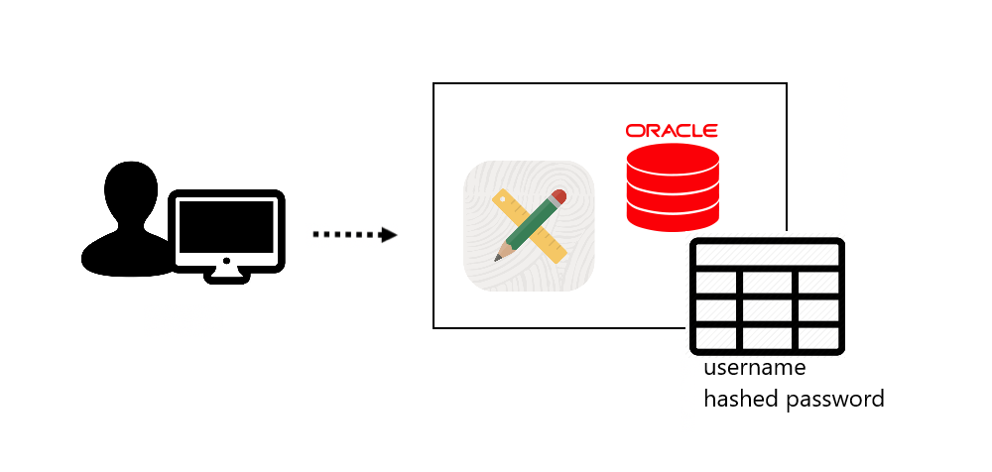
Use case
Current situation

Slide 5
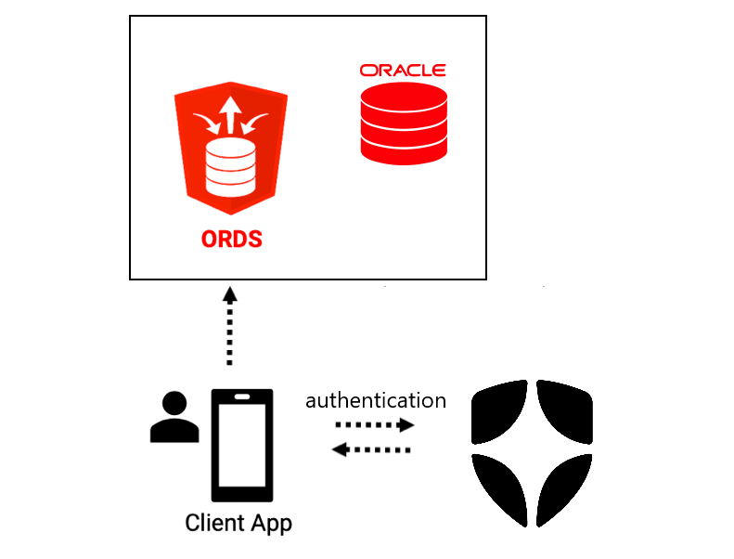
Use case
New situation

Slide 6
ORDS security
Assign privilege to module, and assign to role
Create client (client_id and client_secret) and grant role
OAuth 2 client credentials flow:
  with client_id and client_secret, request token
  use token in Authorization Header in REST calls

Slide 7
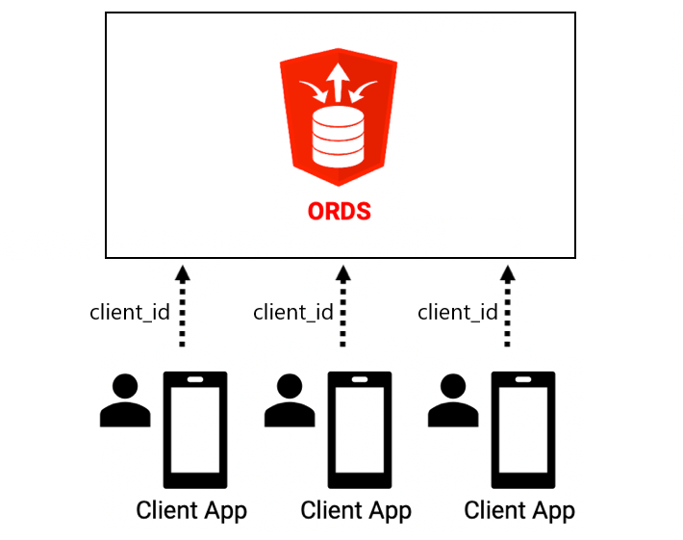
ORDS security
:current_user in ORDS is client_id

Slide 8
ORDS security
Identity Service Provider establishes user identity
Use token from service provider in ORDS call
Can be established with JSON Web Tokens (JWT)

Slide 9
JSON Web Tokens
{
"alg": "RS256",
"typ": "JWT",
"kid": "RNs2Rg3WnWW922nzu30wi"
}
{
"name": "demo@kwintup.nl",
"iss": "https://dev-sumqe035tqxjzhb2.us.auth0.com/",
"aud": "Ggaf8JtC1UkRGG3Zak0hRDQEDiwgS10T",
"sub": "auth0|665b30964c131177be658ad3",
"iat": 1740067861,
"exp": 1740103861,
}
Is JSON
Holds claims, like username or role
Encrypted signature
Structure:
  header
  payload
  signature

Slide 10
JSON Web Tokens
Generated by Identity Service Provider
e.g. Auth0
Decode JWT:
https://jwt.io/
APEX API packages

Slide 11
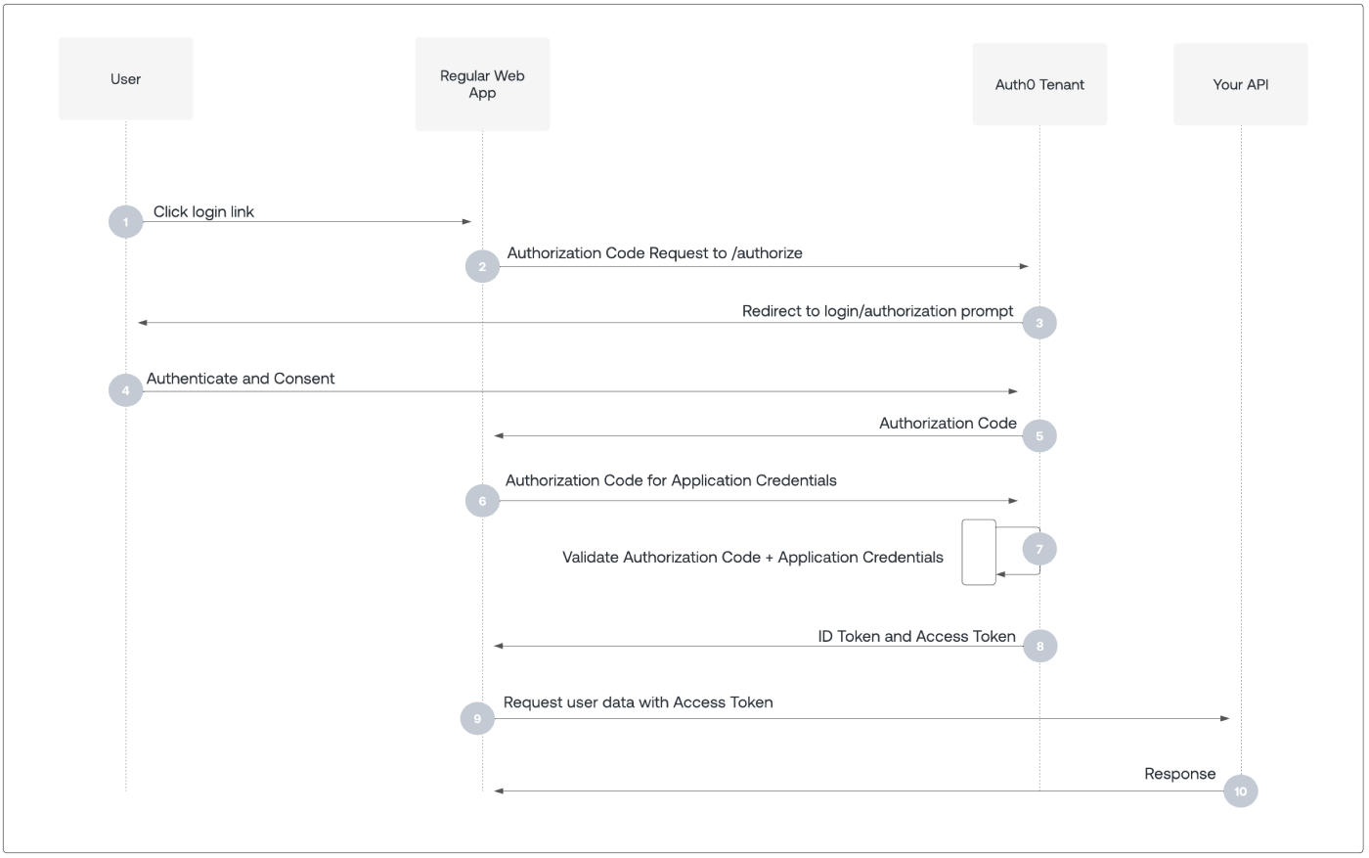
JSON Web Tokens

Slide 12
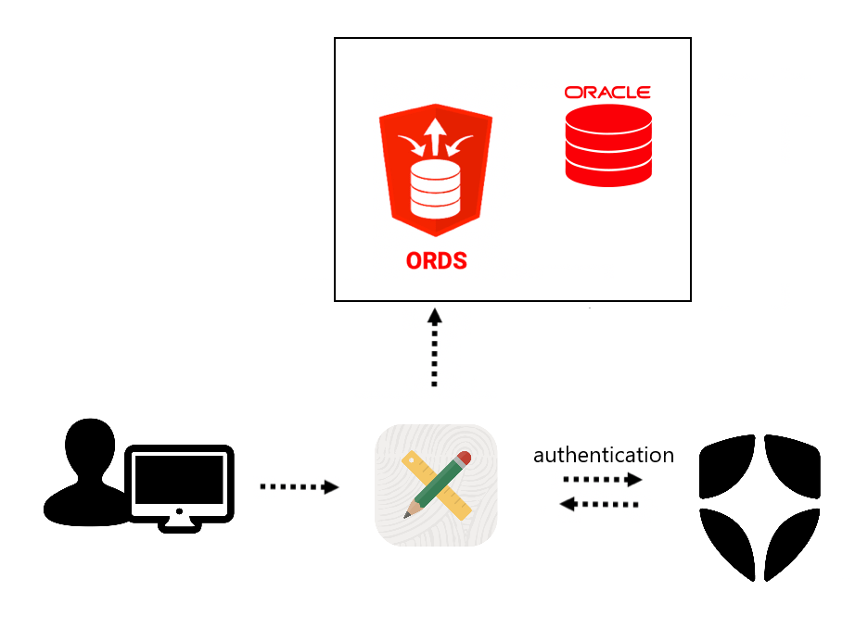
Demo setup
free cloud
apex.oracle.com
Auth0
Notes:
Demo 1
apex.oracle.com
Show Authentication scheme, including post_auth procedure (openid scope!)
Auth0
Show settings
Log into application, paste access token and ID token into jwt.io
Show fields, get public key from advanced settings in Auth0 en verify signature in jwt.io
Show decode tokens in APEX, and code to do that (decode_jwt procedure)
free cloud
Show module and GET handler, and get_relation_csr procedure, and relations table contents
Paste in browser and show returned JSON for ID’s 1,2,3
apex.oracle.com
Show REST Data Source, then page 2, then run page 2, for 1,2,3

Slide 13
ORDS security
Assign privilege to module
Create JWT profile (ORDS 23.3)
  BEGIN
  OAUTH_ADMIN.CREATE_JWT_PROFILE
  ( p_schema =>
  , p_issuer =>
  , p_audience =>
  , p_jwk_url =>
  );
  COMMIT;
  END;
  /
Scope in JWT
Schema (applies to all modules)
Issuer in JWT
Audience in JWT
URL of public key to verify signature
Notes:
Demo 2
In free cloud als admin: draai oauth_admin.create_jwt_profile
BEGIN
OAUTH_ADMIN.CREATE_JWT_PROFILE(
p_schema => 'AW2020',
p_issuer => 'https://dev-sumqe035tqxjzhb2.us.auth0.com/',
p_audience => ' https://mrdwyhtiuwqtluj-dbkwintup01.adb.eu-frankfurt-1.oraclecloudapps.com/ords/aw2020/relations' ,
p_jwk_url => 'https://dev-sumqe035tqxjzhb2.us.auth0.com/.well-known/jwks.json'
);
COMMIT;
END;
/
free cloud
Create privilege read.relinfo (Attention: NO colon!) and assign to module
Show 401 message in browser and apex.oracle.com application
Auth0
Create API APEX World Relation Info
Add permission read.relinfo
apex.oracle.com
Add scope and audience to Authentication Scheme
audience=https://mrdwyhtiuwqtluj-dbkwintup01.adb.eu-frankfurt-1.oraclecloudapps.com/ords/aw2020/relations
scope ,read.relinfo
Log out of application and examine new Access Token (is now JWT, scope, audience)
In REST Data Source, add Authorization parameter
In page 2 add parameter Expression 'Bearer '||:ACCESS_TOKEN
Run page 2, still able to see ID’s 1 and 2

Slide 14
ORDS security
:current_user is “sub” in JWT
Other option:
Include username (email) or custom field like relations_id in JWT
Use APEX_JWT in ORDS procedure to decode JWT in Authorization Header, and extract desired field
Notes:
Demo 3
apex.oracle.com
Run page 3, see value of Curr User
Demo 4
apex.oracle.com
Email is in JWT, not in access token
Auth0
Show user metadata in User Management -> Users
Add fields in Actions -> Triggers -> post-login trigger
apex.oracle.com
Email and relations_id in Access Token
free cloud
Add code to “me” template
declare
l_response sys_refcursor;
l_rawtoken varchar2(4000);
l_token apex_jwt.t_token;
l_email varchar2(1000);
l_relations_id number;
begin
l_rawtoken := replace(:authorization,'Bearer ','');
l_token := apex_jwt.decode(p_value => l_rawtoken);
apex_json.parse(p_source => l_token.payload);
l_email := apex_json.get_varchar2('email');
l_relations_id := apex_json.get_number('relations_id');
open l_response for
select :current_user curr_user
, l_email email
, l_relations_id relations_id
from dual;
:response := l_response;
end;
And add Authorization Parameter
apex.oracle.com
In runtime “me” now Email and Relations Id are shown
free cloud
Now add code to relinfo endpoint
declare
l_response sys_refcursor;
l_rawtoken varchar2(4000);
l_token apex_jwt.t_token;
l_relations_id number;
begin
l_rawtoken := replace(:authorization,'Bearer ','');
l_token := apex_jwt.decode(p_value => l_rawtoken);
apex_json.parse(p_source => l_token.payload);
l_relations_id := apex_json.get_number('relations_id');
if l_relations_id = :relationid then
get_relation_csr ( p_rln_id => :relationid
, p_status_code => :status_code
, p_csr_output => :response
, p_err_output => :errorresponse
, p_content_type => :content_type
);
else
:status_code := utl_http.http_unauthorized;
open l_response for
select 'Relation ID not accessible' error from dual;
:errorresponse := l_response;
end if;
end;
And add Authorization Parameter
apex.oracle.com
In runtime “relinfo” now 1 gives access, 2 not

Slide 15
Final remarks
JWT can be used to authenticate user
Identity Service Provider has to be customized
Ease of customization should be taken into consideration when choosing the Identity Service Provider
Notes:
Demo 3
apex.oracle.com
Run page 3, see value of Curr User
Demo 4
apex.oracle.com
Email is in JWT, not in access token
Auth0
Show user metadata in User Management -> Users
Add fields in Actions -> Triggers -> post-login trigger
apex.oracle.com
Email and relations_id in Access Token
free cloud
Add code to “me” template
declare
l_response sys_refcursor;
l_rawtoken varchar2(4000);
l_token apex_jwt.t_token;
l_email varchar2(1000);
l_relations_id number;
begin
l_rawtoken := replace(:authorization,'Bearer ','');
l_token := apex_jwt.decode(p_value => l_rawtoken);
apex_json.parse(p_source => l_token.payload);
l_email := apex_json.get_varchar2('email');
l_relations_id := apex_json.get_number('relations_id');
open l_response for
select :current_user curr_user
, l_email email
, l_relations_id relations_id
from dual;
:response := l_response;
end;
And add Authorization Parameter
apex.oracle.com
In runtime “me” now Email and Relations Id are shown
free cloud
Now add code to relinfo endpoint
declare
l_response sys_refcursor;
l_rawtoken varchar2(4000);
l_token apex_jwt.t_token;
l_relations_id number;
begin
l_rawtoken := replace(:authorization,'Bearer ','');
l_token := apex_jwt.decode(p_value => l_rawtoken);
apex_json.parse(p_source => l_token.payload);
l_relations_id := apex_json.get_number('relations_id');
if l_relations_id = :relationid then
get_relation_csr ( p_rln_id => :relationid
, p_status_code => :status_code
, p_csr_output => :response
, p_err_output => :errorresponse
, p_content_type => :content_type
);
else
:status_code := utl_http.http_unauthorized;
open l_response for
select 'Relation ID not accessible' error from dual;
:errorresponse := l_response;
end if;
end;
And add Authorization Parameter
apex.oracle.com
In runtime “relinfo” now 1 gives access, 2 not

Slide 16

Questions?

Slide 17


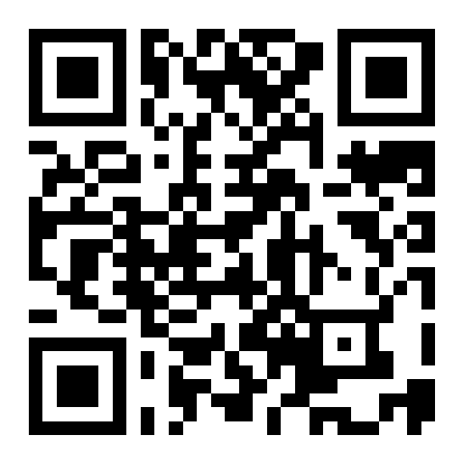
Please fill in your
evaluations

