Slide 1


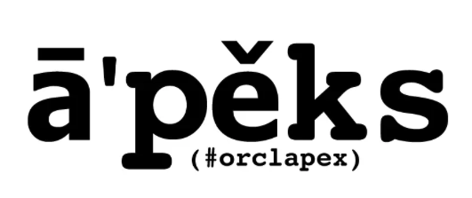



Continuous
Stephan Visser

Slide 2

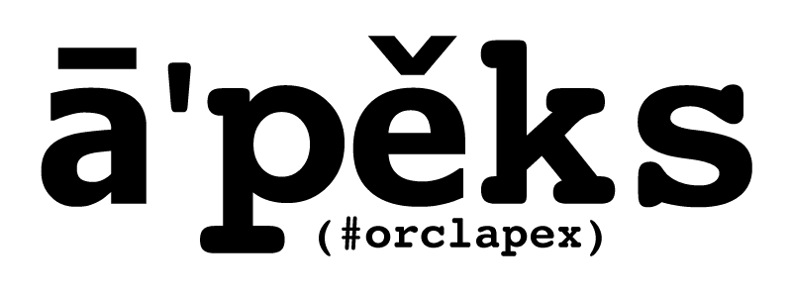
In Formula 1, the term APEX refers to the crucial point in a corner where the driver comes closest to the inside of the turn.
Correctly judging and hitting the APEX makes the difference between smoothly and quickly going through a corner and being left behind or crashing.
Applying DevOps in an APEX project is comparable in that respect and requires a certain degree of “driving skills”.
Photo by Taehoon Kim on Unsplash

Slide 3
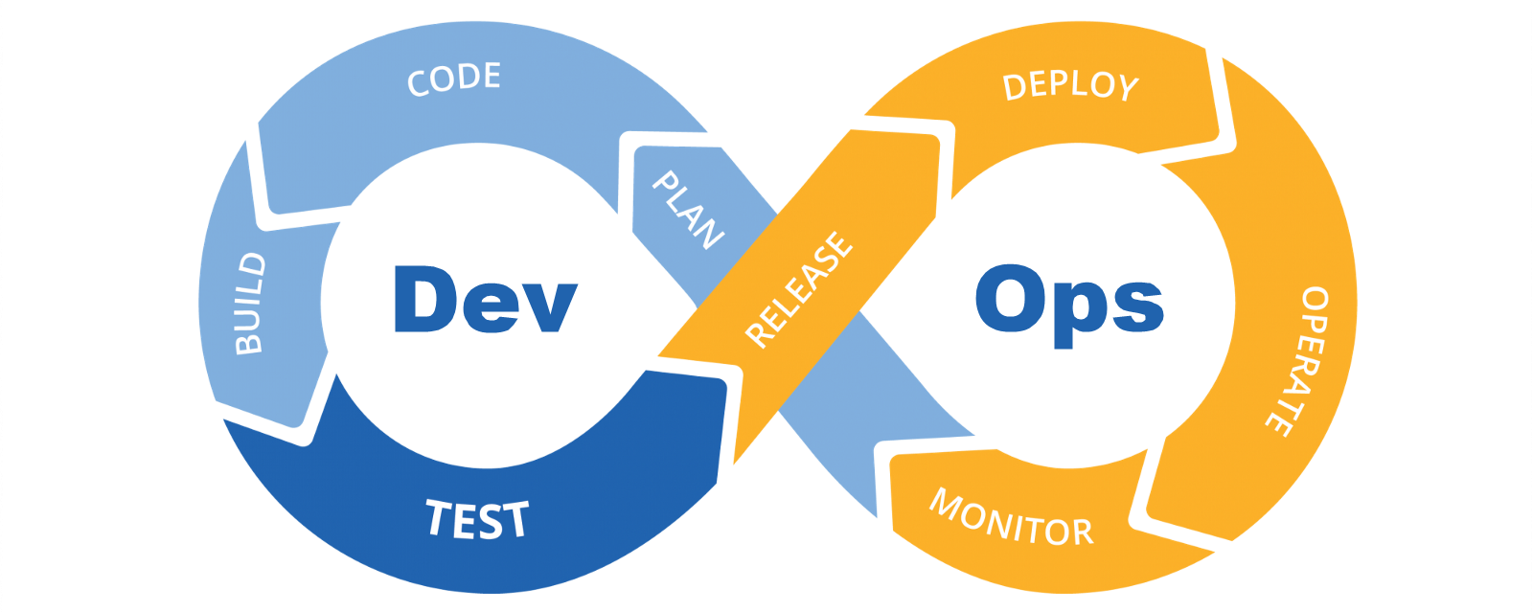
DevOps
DevOps emphasizes the integration of teams, processes, and technology to deliver software in a more effective and reliable way.

Slide 4
Key Aspects of DevOps
People:
  Culture of Collaboration, Communication, Research & Development
Processes:
  Security
  Compliance
  Continuous Improvement
  Configuration Management & Version Control
Technology:
  Infrastructure as Code (IaC)
  Version Control System (VCS)
  Continuous Integration & Delivery (CI/CD)
  Automation
  Monitoring & Logging

Slide 5
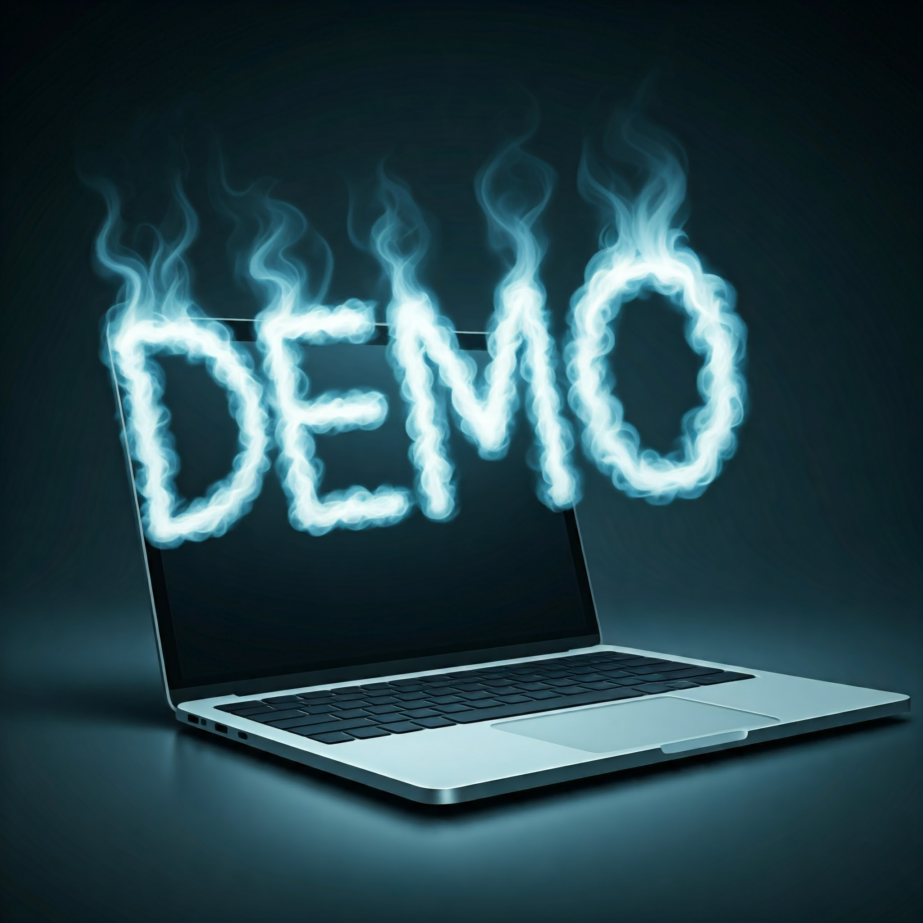

Slide 6
Two Customers, two solutions
Customer “A”
Customer “B”
30 APEX apps in PROD
Mostly former Excel / Access
No DevOps, Yes Agile
No VCS for APEX environments
2 teams (10-15 devs / team)
No DevOps Platform Engineer
2 APEX apps in PROD
Former Designer/Developer
Yes DevOps, Yes Agile
Continuous Improvement
1 team (5 devs)
1 DevOps Platform Engineer
Notes:
Customer A:
All apps in a single workspace
Only SVN as available option for VCS
4 environments with each of them a DB server (Linux), ORDS/Tomcat/Apache (Linux) and a VM for development and operations
Single DEVDB for all developers
Customer B:
2 apps with a lot of pages (400+)
GIT already in use
Azure DevOps server in place
6 environments with each of them a DB server (Linux), a WL server (Linux) and a UTIL server (Windows)
Developers with personal VM
DEVDB in Docker for each developer, changed that to PDB’s

Slide 7

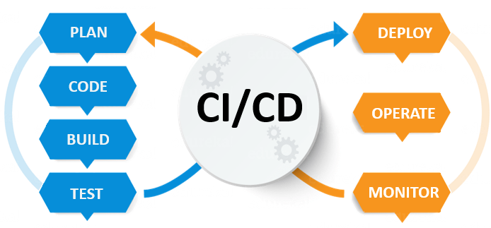
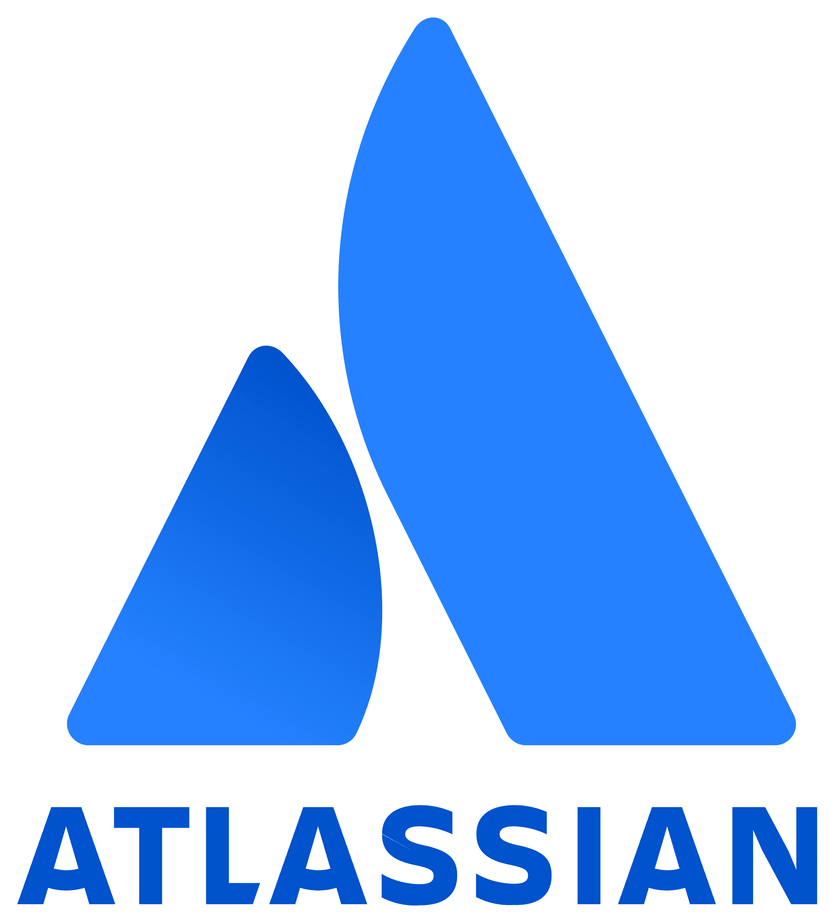
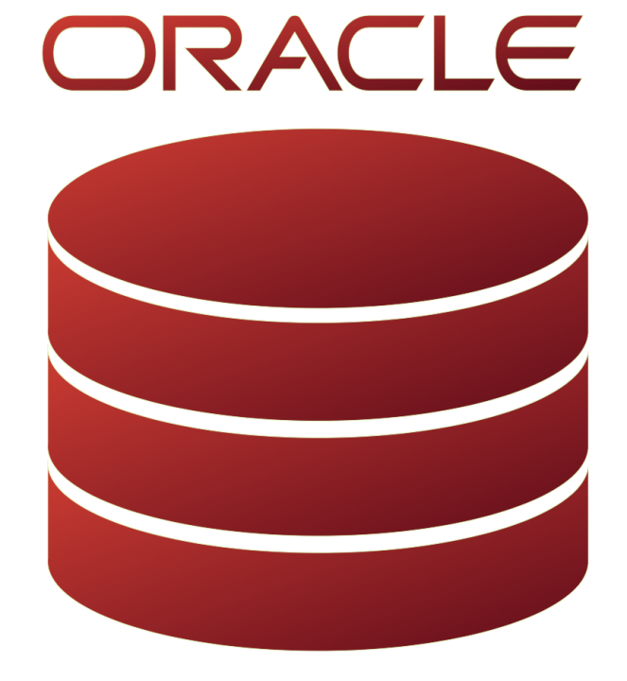
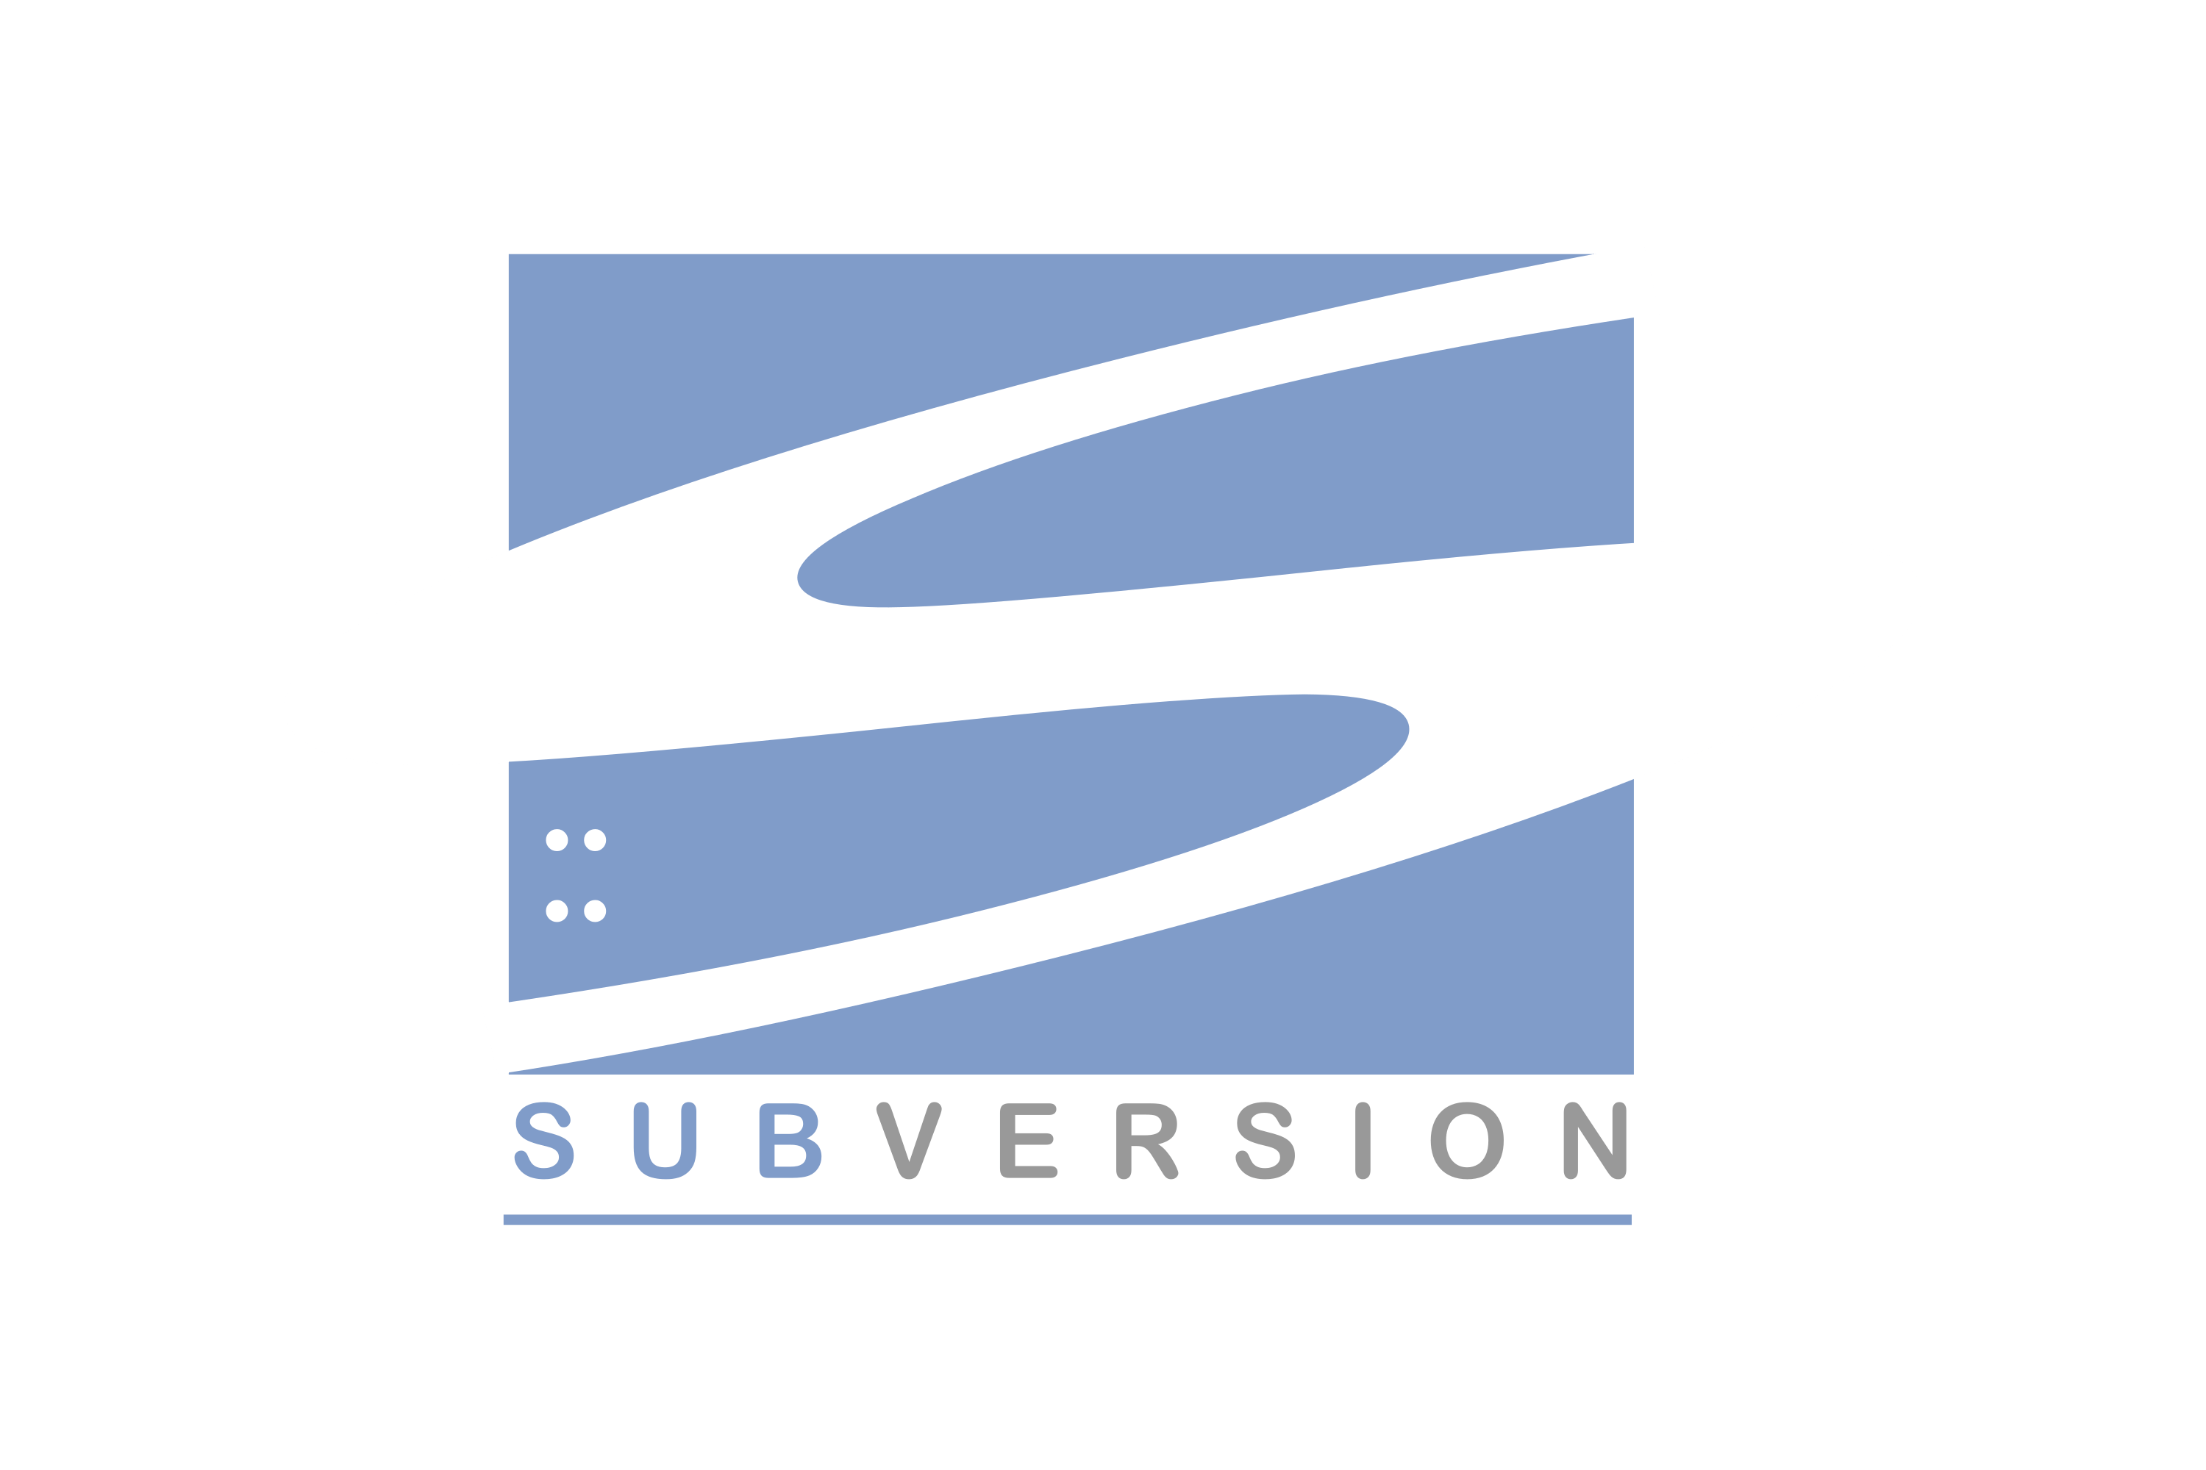
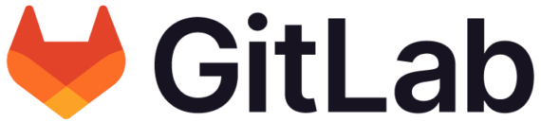

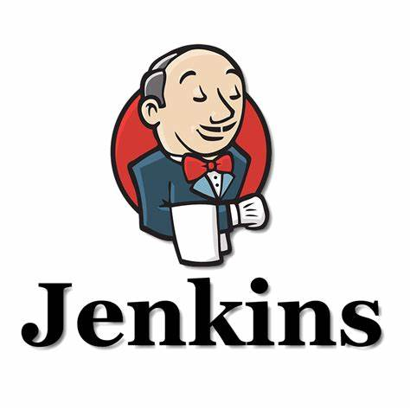

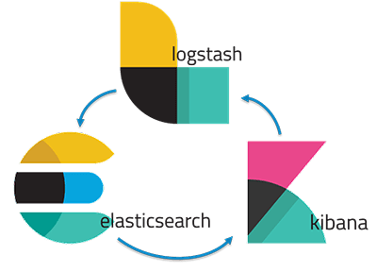
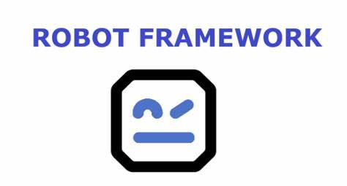
Customer A: Platform Building Blocks
2 teams (10-15 devs)

Slide 8
Customer A: Observations / Lessons Learned
Start with KISS
Do not focus only on tech
Use the right VCS
All apps in a single workspace?
Liquibase is not always necessary
Do not forget to include all parts and pieces
Notes:
Start with KISS
Do not focus only on tech
Agree with Devs and Ops on DevOps platform, workflows etc.
Use the right VCS
SVN is possible but get into GIT asap
Use a simple, effective GIT workflow
All apps in a single workspace?
Liquibase is not always necessary
DDL scripts first, LB later
Database changes done by DBA
Do not forget to include all parts and pieces
Static workspace and application files
Public and private reports
External objects, configuration etc.

Slide 9
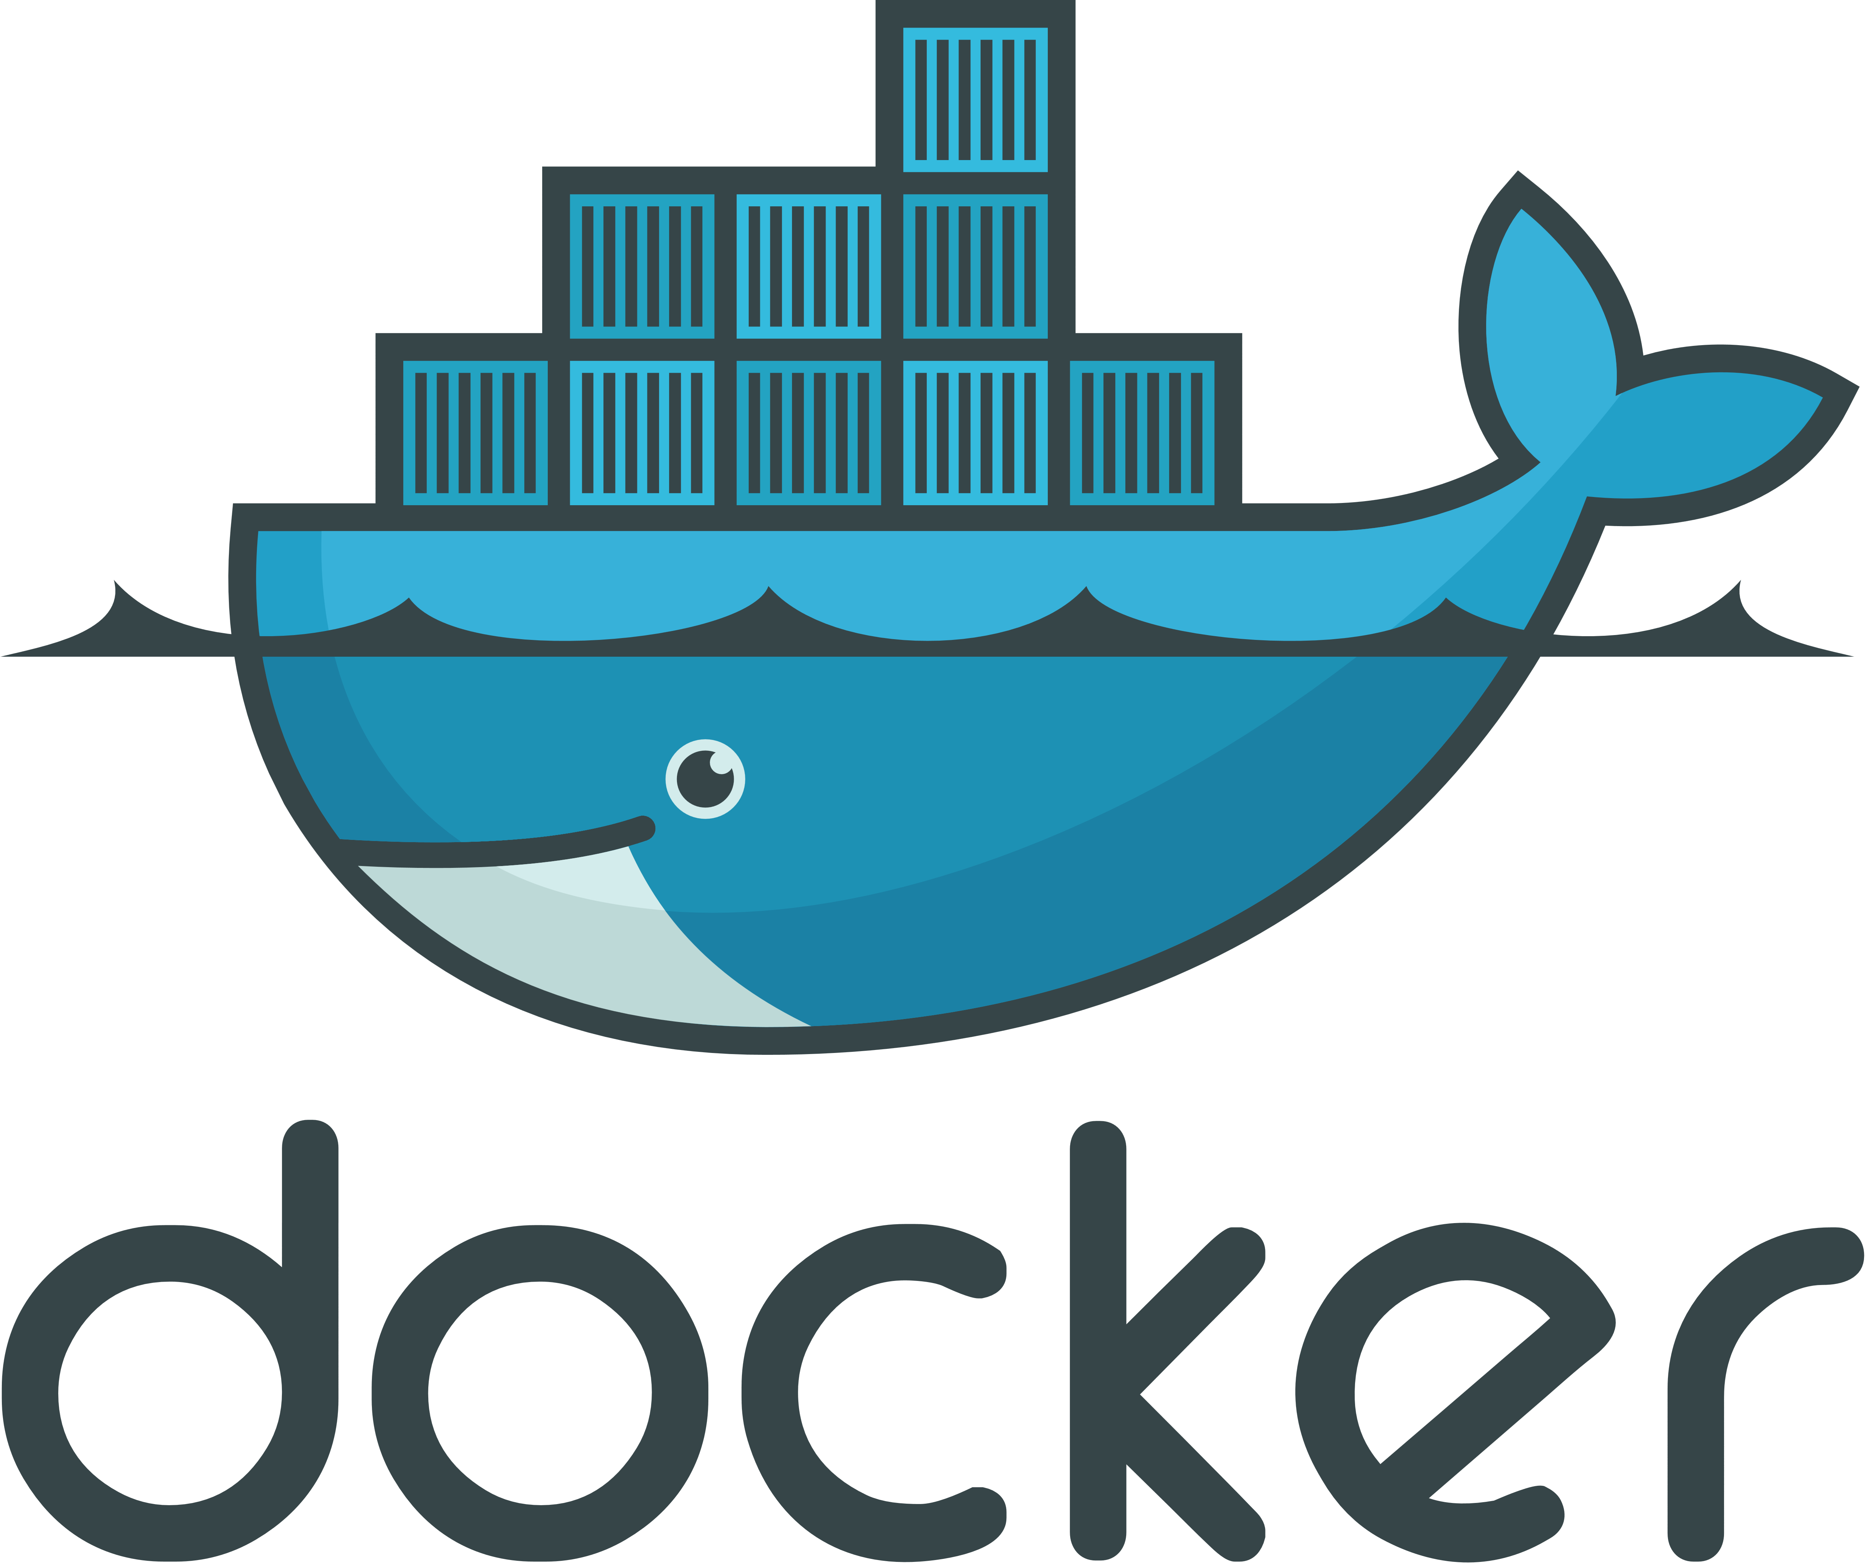
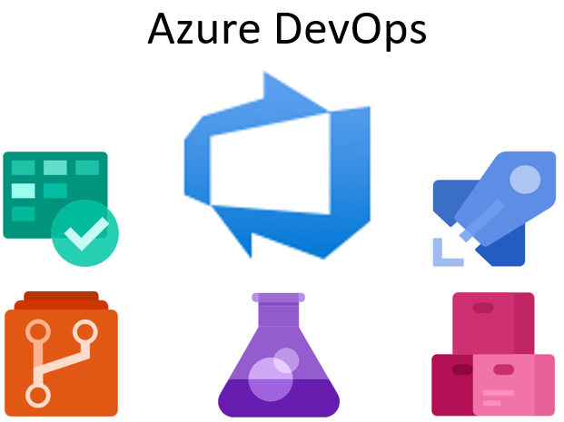
Customer B: Platform Building Blocks
1 team (5 devs)
Notes:
Version Control System (VCS)
Continuous Integration (CI)
Continuous Delivery (CD)
Containerization and Orchestration
Monitoring and Logging
Documentation and Training
Security and Compliance
Configuration Management

Slide 10
Customer B: Observations / Lessons Learned
A complete toolset makes life a lot easier!
Security Matters (a lot)!
A lot of data makes the DevOps’ life difficult
PDBs are great, but introduce some caveats
Notes:
A complete toolset makes life a lot easier!
Azure DevOps Server
Security Matters (a lot)!
DevOps or DevSecOps?
Keep secrets a secret, use a vault
Regularly check for CVEs and security updates
A lot of data makes the DevOps’ life difficult
Minifying for use in PDB
Synchronising PROD data upstream for testing
PDBs are great, but introduce some caveats
Limited PROD data to test with
Dispatcher errors in ORDS
Flashback space management

Slide 12
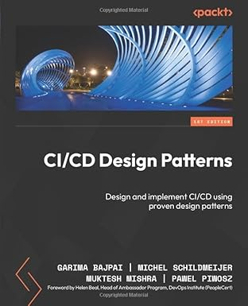
Developing a CI/CD solution
Start with KISS
Make it a parallel project
Add a dedicated DevOps engineer to your team
Develop all stages as separate modules
OS and tool independent
The Gang of Four in DevOps?
Notes:
Start with KISS
Make it a parallel project
Add a dedicated DevOps engineer to your team
Develop all stages separately
Build, Test, Deploy, Monitor
OS and tool independent
Scripting as well as build server
The Gang of Four in DevOps?
Beware of over-engineering

Slide 13

Retrospective
Notes:
Talk about SQLCL Projects in relation to the bespoke DevOps Platform we just looked at.

Slide 14
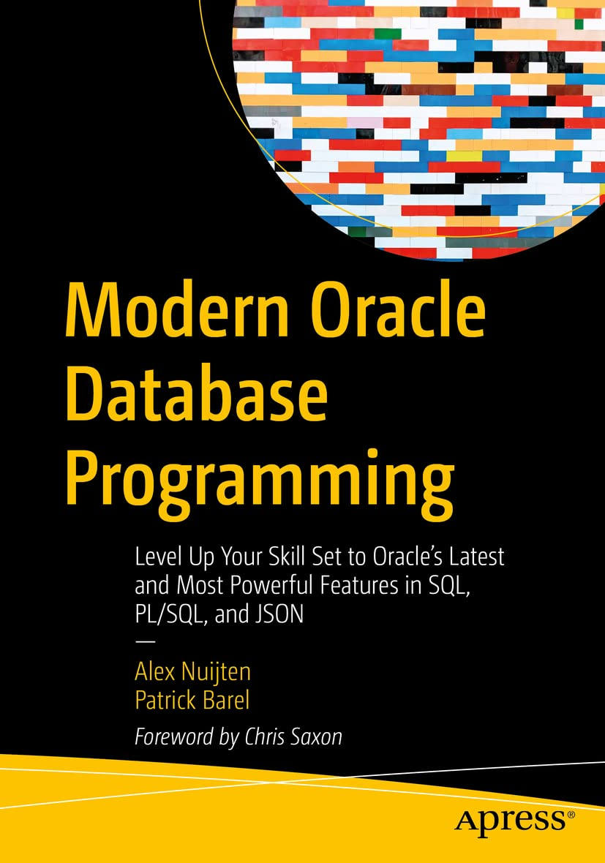

Thank you
Liron Amitzi
Alex Nuijten and Patrick Barel
Michel Schildmeijer
Jess Perry (Jolpica F1)

Slide 15



Please fill in your
evaluations

